Slide 1
Modelleren en Systeemontwerp
Design pattern: decorator

Slide 2

This lecture
Recursion
Decorator pattern

Slide 3

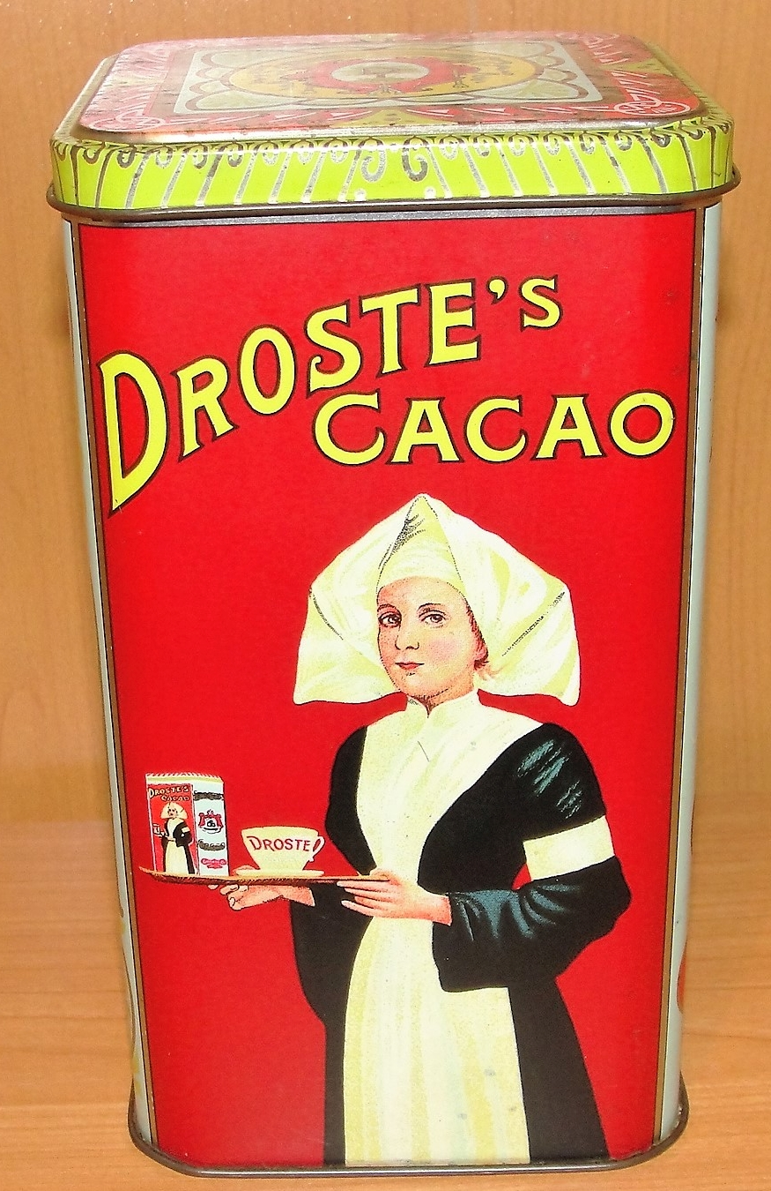
Recursion

Slide 4
Recursion
static void Rec1(int value) {
if (value > 0) {
Console.Write(value);
Rec1 (value - 1);
}
}
Suppose we call this method with parameter 4
The output will be: 4 3 2 1

Slide 5
Recursion
Rec1(4);
-> write(4); Rec1(3);
-> write(3); Rec1(2);
-> write(2); Rec1(1);
-> write(1); Rec1(0);
->
<-
<-
<-
<-
<-

Slide 6
Recursion, another one
static void Rec2(int value) {
if (value > 0) {
Rec1 (value - 1);
Console.Write(value);
}
}
Suppose we call this method with parameter 4
The output will be: ?

Slide 7
Recursion, another one
Rec1(4);
-> Rec1(3);
-> Rec1(2);
-> Rec1(1);
-> Rec1(0);
-> <-
write(1); <-
write(2); <-
write(3); <-
write(4); <-
Output: 1 2 3 4

Slide 8
Recursion
Is a way to express iteration
The code before the recursive method call will be executed in the order of recursion (4 3 2 1)
The code after the recursive method call will be executed in reversed order (1 2 3 4)
Furthermore, recursion . . .
Is omnipresent in functional programming, but . . .
... Keep an eye on termination
Is essential for the Decorator pattern

Slide 9
Towards the decorator pattern
Menu
pannenkoek | stroop
pannenkoek | bosbessenjam
pannenkoek | spek
pannenkoek | kaas
pannenkoek | ui

Slide 10
Towards the decorator pattern
pannenkoek | stroop
pannenkoek | bosbessenjam
pannenkoek | spek
pannenkoek | kaas
pannenkoek | ui
pannenkoek | champignons
pannenkoek | spek & kaas
pannenkoek | spek & stroop
pannenkoek | spek & kaas & stroop
speltpannenkoek | spek & kaas & nog meer kaas
speltpannenkoek | stroop & boerenkool
speltpannenkoek | gin & whiskey & geen pannenkoek maar een glas
…

Slide 11
Towards the decorator pattern
Suppose we have our SalesOrder class, capable of handling different tax calculations (you should recognize the Strategy pattern)

Slide 12
Changing requirements…
But now suppose that we need to print receipts as well

Slide 13
Receipt printing
Each sales receipt may be decorated with additional information in the header and footer
address and tax information
customer loyalty points, if applicable
import/export fees, if applicable
discount code for your next order, if applicable
...

Slide 14
First solution

Slide 15
Critique
This will work but:
you need to include a lot of switches in the Header and Footer classes to decide what to print (bad code smell)
you will mix the code that prints the headers with the control code, deciding which headers to print (weak cohesion)
Can we do better?

Slide 16
The decorator pattern
The Gang of Four describes the intent of the decorator pattern as:
Attach additional responsibilities to an object dynamically. Decorators provide a flexible alternative for extending functionality.

Slide 17
A chain of decorators
Intuitively, you can think of decorators as a chain of Decorator objects that all add some new functionality to concrete component.
Example:
stroop → kaas → spek → speltpannenkoek
How can we organize this in a design?

Slide 18
The decorator pattern

Slide 19
Decorators and recursion
The Decorator class has a recursive component
It uses a two-level deep inheritance hierarchy – for good reason!

Slide 20
Applying the decorator pattern

Slide 21
Keep order!
Note that you can call the next receipt(decorator) before or after executing the component.
class LoyaltyPointsDecorator : ReceiptDecorator {
public void print() {
Console.WriteLine("10 points earned");
receipt.print();
}
}
The order we choose determines whether we get headers or footers.
Question: is LPD a header or a footer?

Slide 22
Ordering example
To produce:
Header1
Base receipt
Footer1
We assemble the following receipt:
new Header1(new Footer1(new BaseReceipt()));
Or equivalently:
new Footer1(new Header1(new BaseReceipt()));

Slide 23
Another ordering example
Header1
Header2
Base receipt
Footer1
We assemble the following receipt:
new Header1
(new Header2
(new Footer1
(new BaseReceipt())));
Order matters!

Slide 24
Another ordering example
But beware:
the creation order is important for the processing order of the headers w.r.t. each other
the creation order is important for the processing order of the footers w.r.t. each other
the order of the recursive method call determines whether it is a header or a footer

Slide 25
Decorators in OO languages
I/O in C# and Java uses lots of decorators
C# defines an abstract Stream class with methods like BeginRead and Close
There are concrete instances for writing to a file, network socket, etc.
Using decorators, you can define your own instance that
decrypts the data
zips the data
buffers data
converts the data
...

Slide 26
Decorators: review
Intent: Attach additional responsibilities to an object dynamically.
Problem: The object you want to use does the basic functions you require. However, you may need to add some additional functionality to the the object, occurring before or after the object’s basic functionality.
Solution: Allows for extending the functionality without resorting to subclassing.
Participants: The ConcreteComponent is the base class, that is extended with Decorators. Their common abstract superclass, Component, defines the interface for both the ConcreteComponent and Decorator classes.
Consequences: The functionality that needs to be added should be done in (small) Decorator objects. These decorator objects can then be dynamically wrapped around the ConcreteComponent as necessary.

Slide 27
Material covered
Design Patterns explained: chapter 16

